Slide 1
Lecture 10: Main Development of Cloud Computing

Slide 2


Brief History of Cloud Computing:
Later 1990s, https://www.salesforce.com/ pioneered the notion
2002, https://www.amazon.com/ launched Amazon web service (AWS) platform
A suite of enterprise-oriented service
Provide remotely provisioned storage, computing resource, and business functionality
Early 2008, Eucalyptus became the first open-source, AWS API-compatible platform for deploying private clouds
March 1, 2011 IBM announced the IBM SmartCloud
June 7 2012, Oracle Cloud
(story goes on …)
Bringing remotely provisioned services into enterprise …

Slide 3
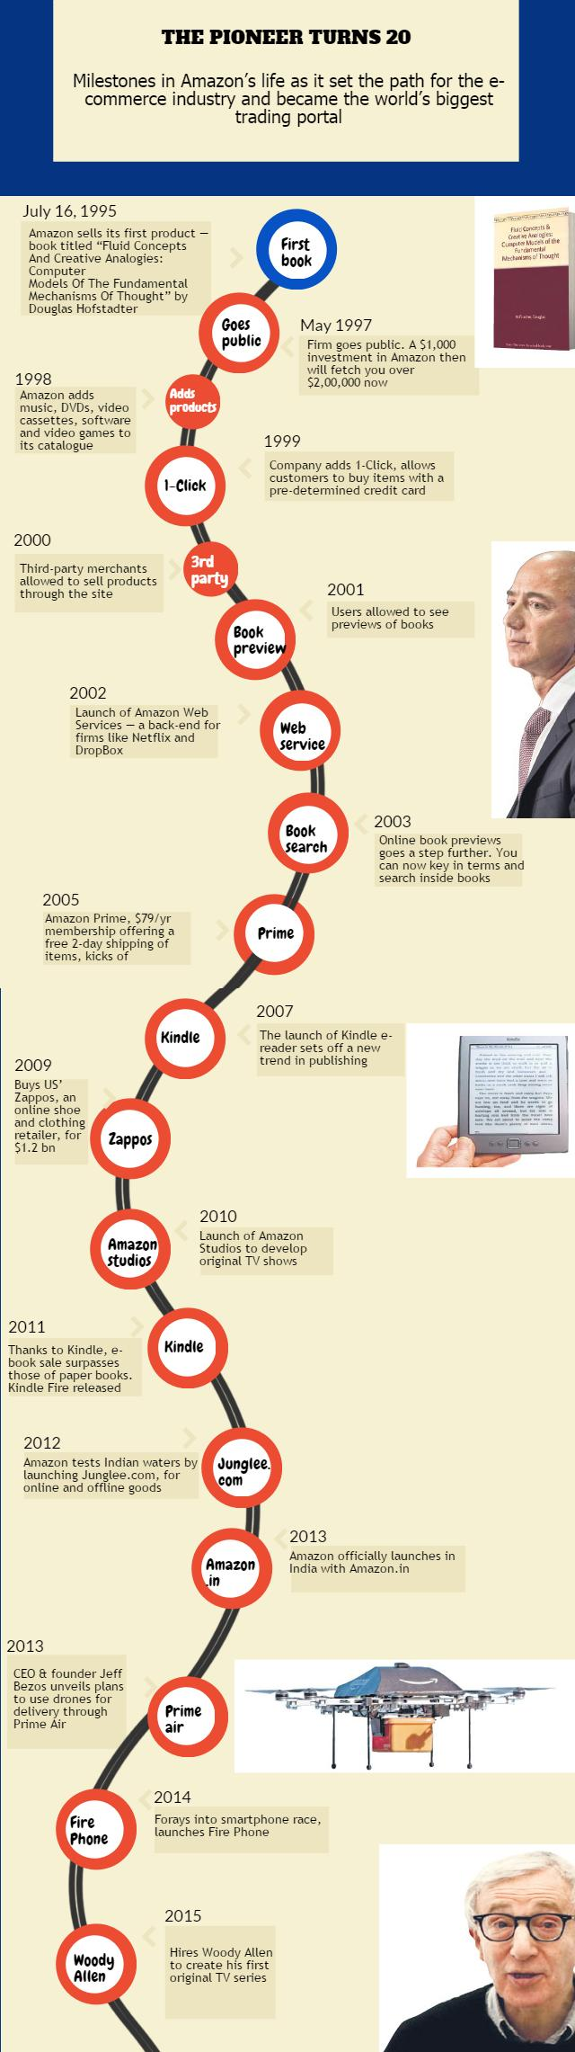
Amazon Milestones

Slide 4


Alibaba Cloud
2009.09 – Alibaba Cloud is founded
Center opened in Hangzhou, Beijing, and Silicon Valley.
2010.11 – 11.11 https://world.taobao.com/ with 2.4 billion transactions in 24 hours.
2013.08 – ApsaraDB architecture, 5000 physical machines in a single cluster.
2014.05 – Hong Kong data center went online.
2015.10 – Two US data centers went online.
October 2015 – Alibaba Cloud Computing Conference in Hangzhou。
November 2015 – 11.11 new records: $14.2 billion transactions in 24 hours.
July 2017 – Alibaba Cloud official website is changed from intl.aliyun.com to www.alibabacloud.com.

Slide 5
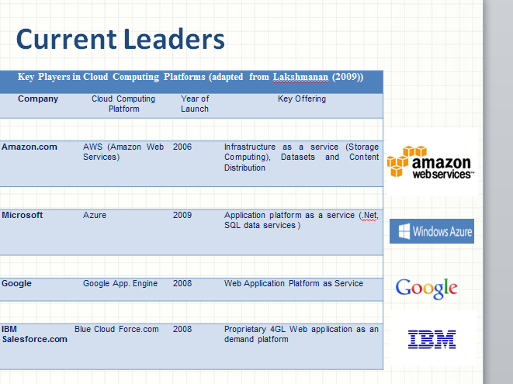

Slide 6
EMEA is an acronym that stands for Europe, Middle East, and Africa. This region includes all of the countries found in Africa, Europe, and the Middle East.
APAC: Asia-Pacific

Slide 7
Our Approach
There are so many cloud companies, each providing a list of services
In the lectures we only studied a few selected top companies
Google (Google Cloud), Amazon (Amazon AWS), Microsoft (Microsoft Azures)
And for each of the above companies we only discuss a small subset of services provided
Introduce a few services and discuss one or two services in details
Students are encouraged to study other cloud services/companies through self-study, group assignments, and team project.

Slide 8
Activity #1
Name the top five cloud service providers for this year.
Name your most favorite cloud service provider and most favorite cloud service.

Slide 9

Case Study 1: Google

Slide 10
Activity #2
About Google
True or False:
Google was founded by two graduate students of Harvard University
Like Apple, Google’s first office location was a garage.
What popular google services you have used?

Slide 11



Google
In addition to the world’s most powerful search engines, google offers
Google maps
Google earth
Gmail
YouTube
…
Characteristics of these applications
Massive (gigantic, …) data
Challenges
Big data storage and fast processing

Slide 12
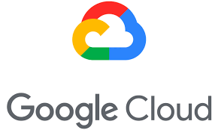
Google’s Solution
Google’s cloud computing model
Use millions of cheap computers working together to solve large problems
Simple and effective
Google’s cloud computing technology
Google File System GFS
MapReduce distributed computing model
Distributed lock service Chubby
Distributed data structure Bigtable
…

Slide 13
SaaS services offered by Google
Gmail - hosts Emails on Google servers and provides a web interface to access the Email.
Google docs - a web-based software for building text documents, spreadsheets and presentations.
Google Calendar - a browser-based scheduler; supports multiple user calendars, calendar sharing, event search, display of daily/weekly/monthly views, and so on.
Google Groups - allows users to host discussion forums to create messages online or via Email.
Picasa - a tool to upload, share, and edit images.
Google Maps - web mapping service; offers street maps, a route planner, and an urban business locator for numerous countries around the world

Slide 14
PaaS services offered by Google
AppEngine - a developer platform hosted on the cloud.
Initially supported Python, Java was added later.
The database for code development can be accessed with GQL (Google Query Language) with a SQL-like syntax.
Google Co-op - allows users to create customized search engines based on a set of facets/categories.
Google Drive - an online service for data storage.
Google Base - allows users to load structured data from different sources to a central repository, a very large, self-describing, semi-structured, heterogeneous database.

Slide 15
IaaS services offered by Google
Google Compute Engine
Google Cloud Platform (GCP)
What about Google Drive ??

Slide 16
Activity #3: Discussion
Can we say Google drive and Dropbox are an example of IaaS?

Slide 17
Previously Google Drive (similarly Dropbox) is classified as SaaS service.
Currently some literatures classify Google Drive (same for Dropbox) as IaaS service.
A precise description: Google Drive is a software (SaaS) that we can use a storage (IaaS) and network (NaaS) to store and share documents.

Slide 18
Description of selected google cloud services

Slide 19
What is Google GFS?
Google File System (GFS) is a proprietary distributed file system developed by Google for its own use.
Not open source
It is designed to provide efficient, reliable access to data using large clusters of commodity hardware.
A new version of the Google File System is codenamed Colossus.
GFS is clusters of computers. A cluster is simply a network of computers. Each cluster might contain hundreds or even thousands of machines. In each GFS clusters there are three main entities:
1. Clients
2. Master servers
3. Chunk servers.

Slide 20
GFS Cluster
A GFS cluster consists of multiple nodes
Two types of nodes
one Master node and a large number of Chunk servers.
Each file is divided into fixed-size chunks, typically of 64 megabytes
Chunk servers store these chunks.
Each chunk is assigned a unique 64-bit label by the master node at the time of creation/
Logical mappings of files to constituent chunks are maintained.
Each chunk is replicated several times throughout the network.
At default, it is replicated three times, but this is configurable.

Slide 21
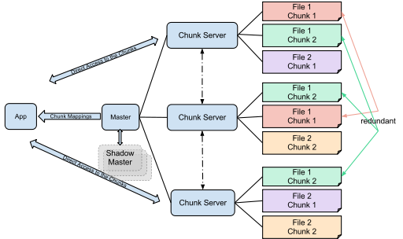
GFS Cluster
Chunk servers store file chunks, which are replicated.
Three main entities:
1. Clients/App
2. Master servers
3. Chunk servers.
https://en.wikipedia.org/wiki/Google_File_System

Slide 22
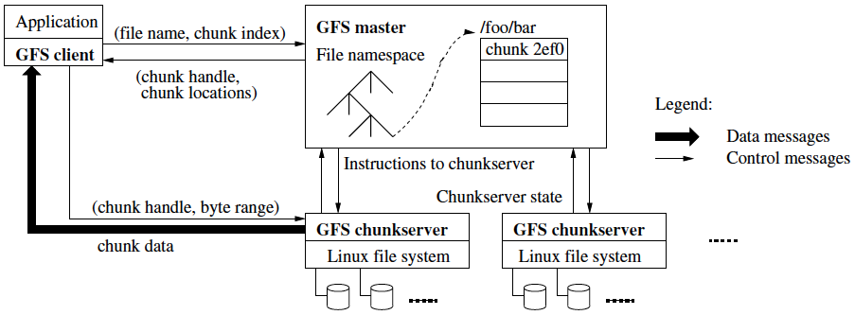
GFS Architecture
Client can be other computers or computer applications and make a file request. Requests can range from retrieving and manipulating existing files to creating new files on the system. Clients can be thought as customers of the GFS.
http://programming-project.blogspot.com/

Slide 23
What is Google MapReduce?
MapReduce
For distributed processing of big data
Derived from functional and vector programming concepts
A software framework that allows developers to write programs that process massive amounts of unstructured data in parallel across a distributed cluster of processors or stand-alone computers.
Developed at Google for indexing Web pages and replaced their original indexing algorithms and heuristics in 2004.
Suitable for parallel processing of big data (typically > 1TB)

Slide 24
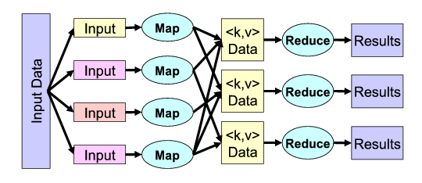
Input Data splits to chunks, each processed by a Map task; the intermediate result in the form of <key, value> pair sent to Reduce task to produce results.
Dean and Ghemawat “MapReduce: Simpliﬁed Data Processing on Large Clusters”

Slide 25
Map() and Reduce()
Map, a function that parcels out work to different nodes in the distributed cluster.
Reduce, another function that collates the work and resolves the results into a single value.
https://www.ibm.com/developerworks/cloud/library/

Slide 26
Example: WordCount
//WordCount pseudo code
function map(String name, String document):
// name: document name
// document: document contents
for each word w in document:
emit (w, 1)
function reduce(String word, Iterator partialCounts):
// word: a word
// partialCounts: a list of aggregated partial counts
sum = 0
for each pc in partialCounts:
sum += pc
emit (word, sum)
This canonical MapReduce example counts the appearance of each word in a set of document.
Reference: https://en.wikipedia.org/wiki/MapReduce

Slide 27
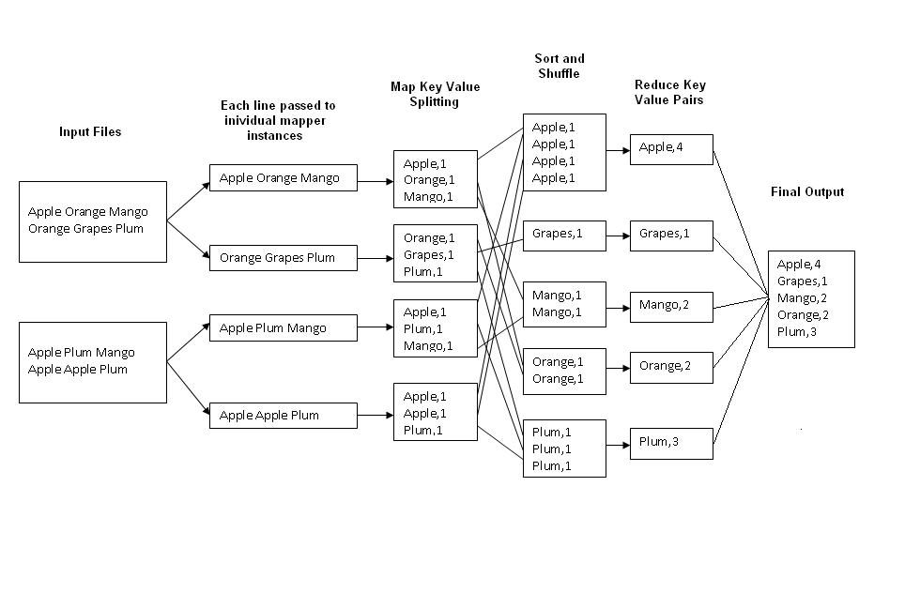
MapReduce WordCount Illustration
https://stackoverflow.com/

Slide 28
Why MapReduce?
Huge computation involved in cloud computing
For example, it is said that every google search in average requires 10¹¹ computations
The MapReduce framework balances server workloads thus improves overall performance
The MapReduce framework is fault-tolerant
Each node in the cluster is expected to report back periodically with completed work and status updates.
If a node remains silent for longer than the expected interval, a master node makes note and re-assigns the work to other nodes.

Slide 29
What is Chubby?
Chubby is a lock service in a loosely-coupled distributed system. Basically,
it's a method to insure that each user can only see their own files on Google's servers (the files are locked,) and
all of those services work together across multiple servers.
Reference: The Chubby lock service for loosely-coupled distributed systems, by Mike Burrows, Google Inc.
static.googleusercontent.com

Slide 30
Why Lock Service?
Operating systems use lock managers to organize and serialize the access to shared resources.
A distributed lock manager (DLM) runs in every machine in a cluster, with an identical copy of a cluster-wide lock database.
A DLM provides software applications distributed across a cluster on multiple machines with a means to synchronize their accesses to shared resources.
DLMs have been used as the foundation for several successful clustered file systems
In Chubby it uses the Paxos protocols for solving consensus in a network of unreliable processors.
Paxos algorithm is considered as a fundamental theory for cloud computing
We will discuss Paxos algorithm as an advanced topic (optional coverage)

Slide 31
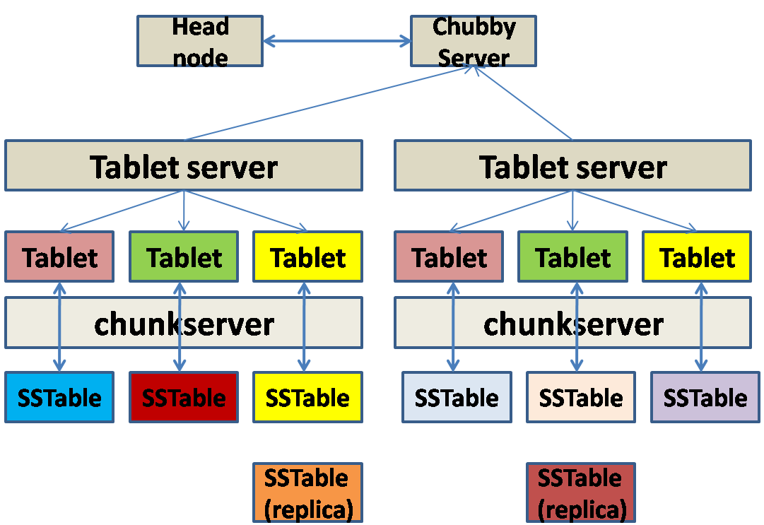
Framework of Chubby
Chubby exposes a file-system like interface, and nodes may be either permanent or temporary.
Each Chubby file and directory can act as a lock – either one client can hold it in write mode, or any number of clients can hold it in read mode.
researchgate.net

Slide 32
What is a Bigtable?
A compressed, high performance, and proprietary data storage system
built on Google File System, Chubby Lock Service, SSTable (log-structured storage like LevelDB) and a few other Google technologies.
It is not distributed outside Google
although Google offers access to it as part of its Google App Engine.
A distributed storage system structured as a large table
may be petabytes in size and distributed among tens of thousands of machines.
designed for storing items such as billions of URLs, with many versions per page; over 100 TB of satellite image data; hundreds of millions of users
perform thousands of queries a second.

Slide 33
Bigtable
designed with semi-structured data storage in mind.
It is a large map that is indexed by a row key, column key, and a timestamp.
Each value within the map is an array of bytes that is interpreted by the application.
Every read or write of data to a row is atomic, regardless of how many different columns are read or written within that row.
An open source version, Hbase, was created by the Apache project on top of the Hadoop core
Hadoop: open source implementation of Google’s MapReduce by Apache project (to be discussed later)

Slide 34
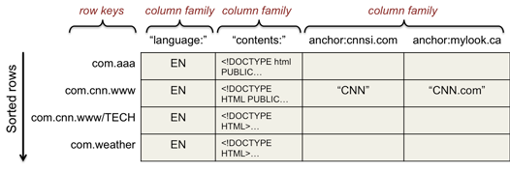
Bigtable column families
Note: reversed order in row keys, i.e. com.weather instead of weather.com for fast searching

Slide 35
Google App Engine
Google App Engine lets you run web applications on Google's infrastructure.
App Engine applications are easy to build, easy to maintain, and easy to scale as your traffic and data storage needs grow.
With App Engine, there are no servers to maintain
You just upload your application, and it's ready to serve your users.
Once you have signed up for a cloud account, using these programming languages to build a simple guest book application.

Slide 36
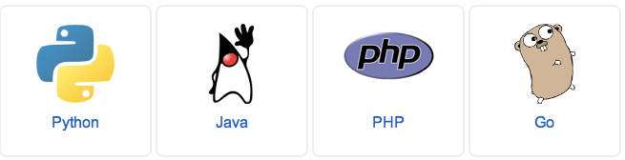
Available programming languages for Google App Engine
More to add?

Slide 37
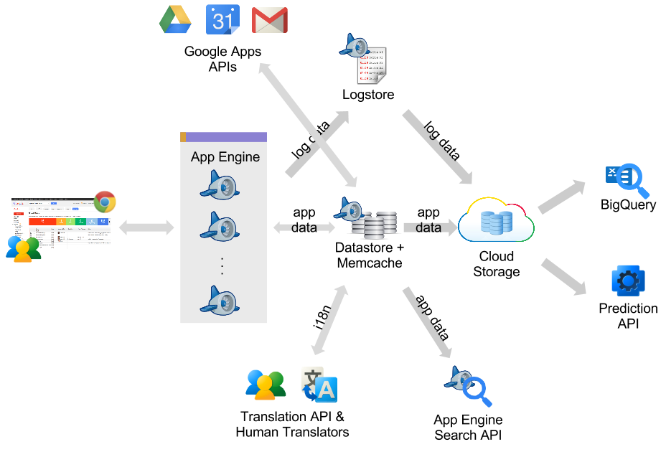
Google App Engine System Architecture
http://googlecloudplatform.blogspot.com/2012_10_01_archive.html

Slide 38
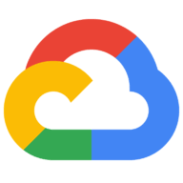
Google cloud services: a lot more to explore … visit https://cloud.google.com

Slide 39
Activity #4
What does Google cloud computing technologies include?
What are the main features of GFS?
What are the advantages of MapReduce programming? Is MapReduce good for read-time streaming?
What is the goal of Chubby?
Describe Bigtable and its architecture?
What services are provided by Google App Engine?

Slide 40
Summary
Google Cloud Computing
Discussion of selected services
Assignment
Complete all activities based on in-class discussion
Next Lecture
AWS cloud service
Student’s Preparation
Compare and contrast the cloud services provided by Google and Amazon

